Slide 1
Floral Design Tools
Principles & Elements of Floral Design
Miss Prause

Slide 2
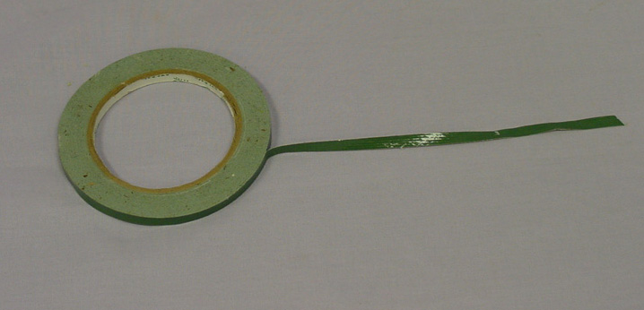
Anchor Tape

Slide 3
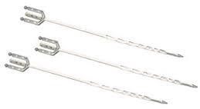
Cardette/Card Holder

Slide 4
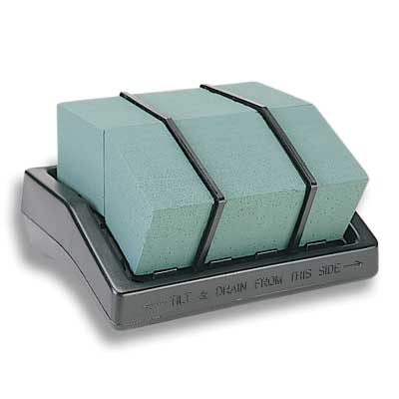
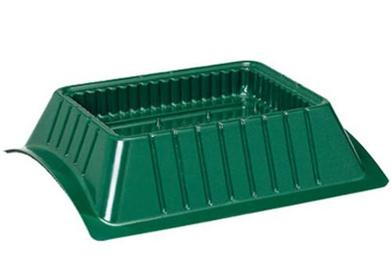
Casket Saddle

Slide 5
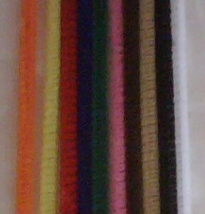
Chenille Stems (AKA Pipe Cleaners)

Slide 6
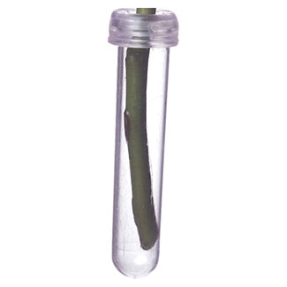
Water Tubes

Slide 7
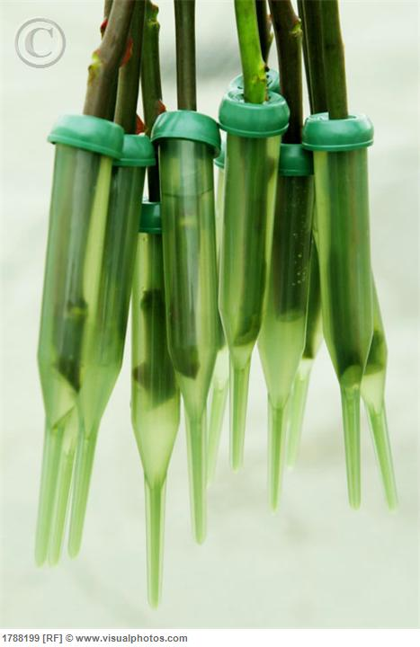
Water Picks

Slide 8
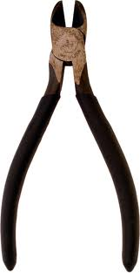
Wire cutters

Slide 9
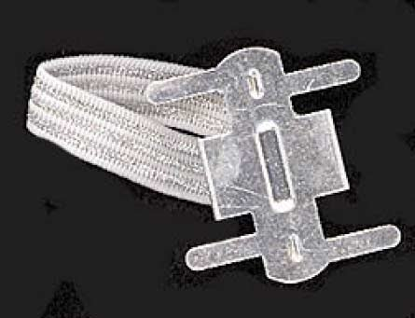
Wrist Corsage Holder

Slide 10
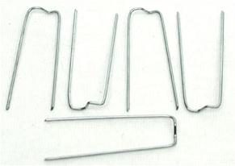
Greening pins

Slide 11
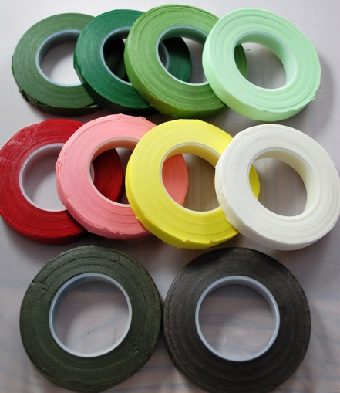
Floral Tape

Slide 12
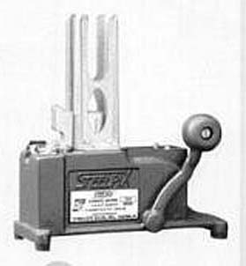
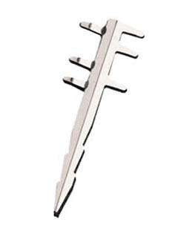
Pick Machine and Metal Picks

Slide 13
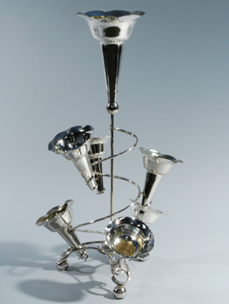
Nosegay Holder

Slide 14
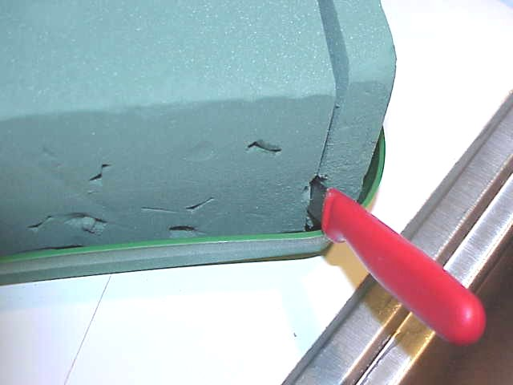
Wet Floral Foam (Oasis)

Slide 15
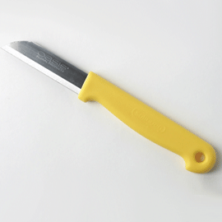
Floral Knife

Slide 16
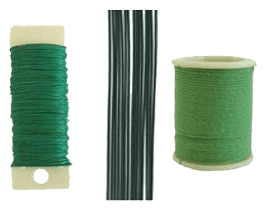
Florist Wire

Slide 17
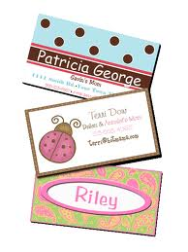
Enclosure Card

Slide 18
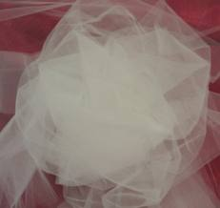
Tulle

Slide 19
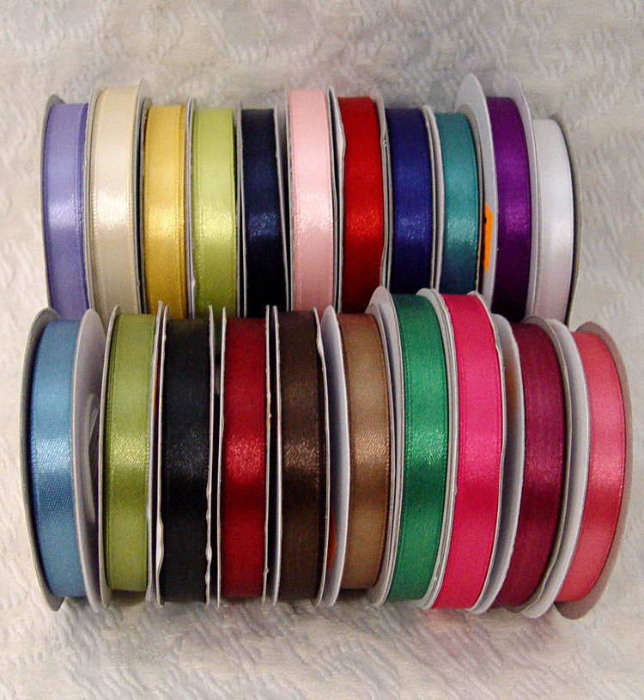
# 3 ribbon

Slide 20
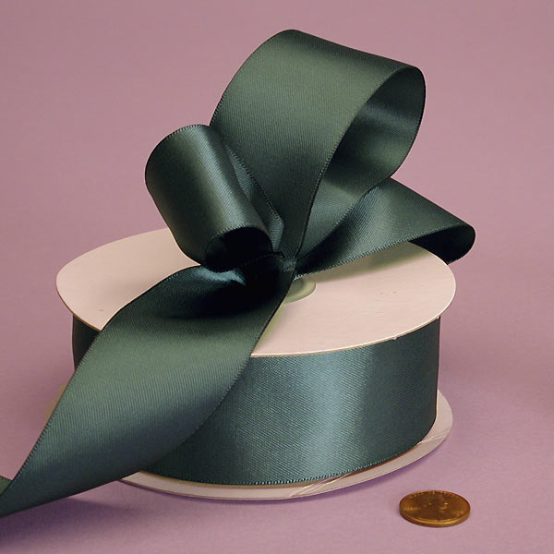
# 9 ribbon

Slide 21
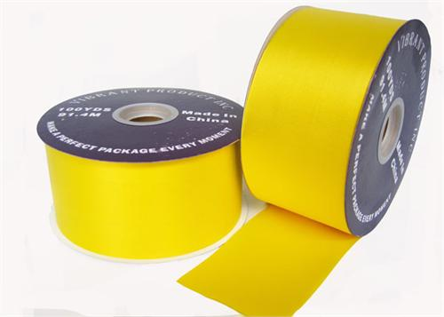
# 40 ribbon

Slide 22
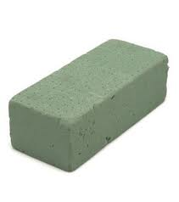
Styrofoam

Slide 23
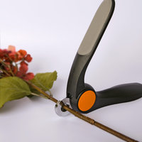
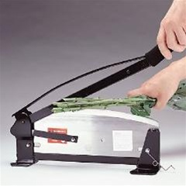
Stem Cutter

Slide 24
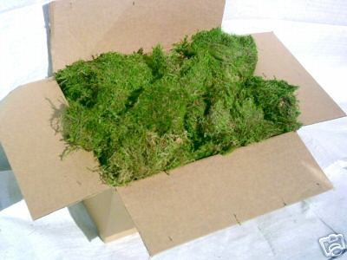
Sheet Moss

Slide 25
Wire Easel

Slide 26
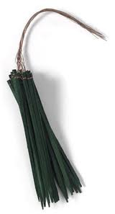
Wooden Pick

Slide 27
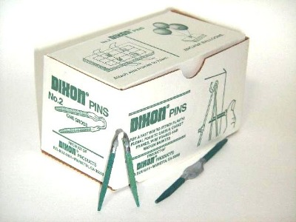
Dixon Pin

Slide 28
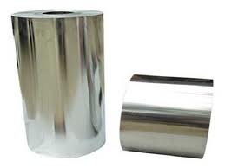
Polyfoil

Slide 29
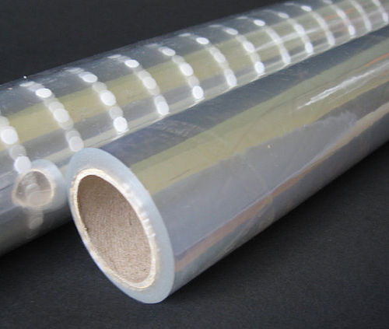
Cellophane

Slide 30
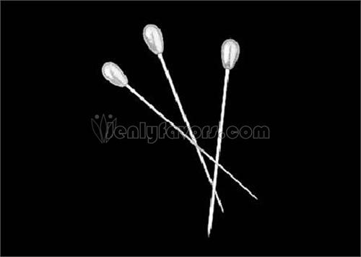
Corsage Pin

Slide 31
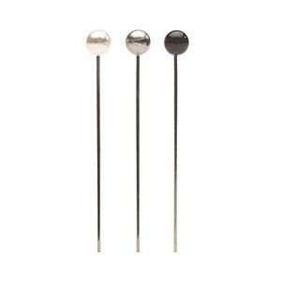
Boutonniere Pin

Slide 32
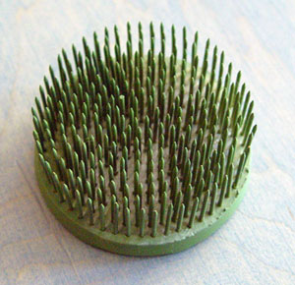
Pin Holder (frog)

Slide 33
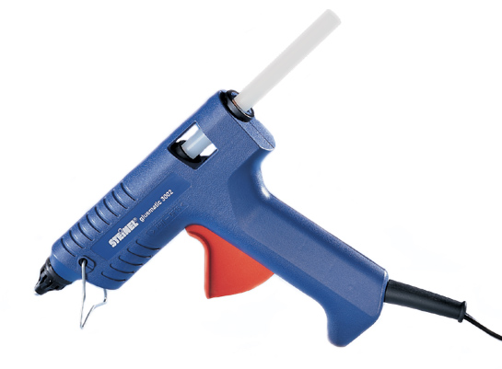
Glue Gun

Slide 34
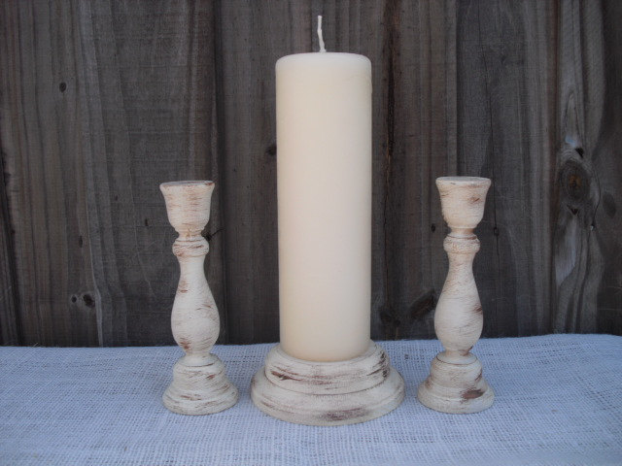
Candle Pick/Holder

Slide 35
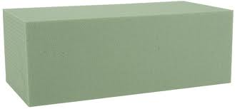
Dry Foam

