Slide 2
Objectives
To discuss tools used for basic surgical procedures in livestock.
To understand the importance of each procedure.
To examine the techniques used in each basic surgical procedure.

Slide 3
Main Menu
Dehorning
Castration
Tail Docking, Teeth Clipping & Lancing

Slide 5
Dehorning
Is the surgical removal of horns and horn-producing tissues
Should be performed as early in the animal’s life as possible
reduces the risk of complications
younger animals heal faster and experience less stress
Surgical Scoop: All surgical procedures discussed should be performed on healthy animals. Performing procedures on ill animals can increase the risks associated with the procedure.

Slide 6
Dehorning
Increases the safety of individuals and other animals
Increases profits at market
Decreases the chance of bruised carcasses
bruising reduces meat value
Allows for more room at the feed trough
Makes animals easier to handle
Surgical Scoop: Animals are provided with a sedative to induce analgesia. Analgesia is defined as the inability to experience pain during a procedure.

Slide 7
Dehorning Tools
For nursing animals include:
chemical pastes or sticks
hot iron
spoon or tube dehorners
For weaned animals include:
cup dehorners
scoop dehorners
Surgical Scoop: Some animals are born without horn-producing tissue. These animals are referred to as “polled”.

Slide 8
Chemical Dehorning
Is the application of caustic paste/sticks to the horn buds
completed between one to three weeks of age
Destroys horn-producing cells surrounding the horn buds
Surgical Scoop: “Caustic” by definition is a substance which is able to burn or corrode organic tissue by chemical action.

Slide 9
Chemical Dehorning
Includes the following types:
caustic chemical paste
caustic sticks
Safety precautions to follow are:
always wear gloves
do not preform in rainy weather

Slide 10
Chemical Dehorning Equipment

Slide 11
Chemical Dehorning
Advantages include:
less stressful compared to other procedures
bloodless
can be performed year-round
Disadvantages include:
painful without anesthesia
scurs could grow following improper techniques
not permitted in some countries
Surgical Scoop: Loose horns which are attached by skin rather than bone are known as scurs.

Slide 12
Chemical Dehorning
Steps include:
administering anesthetic
uncovering horn bud
push back hair surrounding the horn bud
applying a thin layer of caustic chemical paste to horn bud
use a wooden applicator
repositioning hair over applied paste
placing an adhesive patch over each horn bud
protects other animals from accidental burns

Slide 13
Hot Iron Dehorning
Uses the hollow circle of a heated iron to destroy the horn-producing skin
should fit around the horn bud
Is the preferred method to use on animals 12 weeks or older
Surgical Scoop: When dehorning using a hot iron, it is extremely important to have skills and knowledge of the procedure and to always wear gloves.

Slide 14
Hot Iron Dehorning Equipment
Can include the following types:
furnace heated
12-volt battery operated
120-volt electric

Slide 15
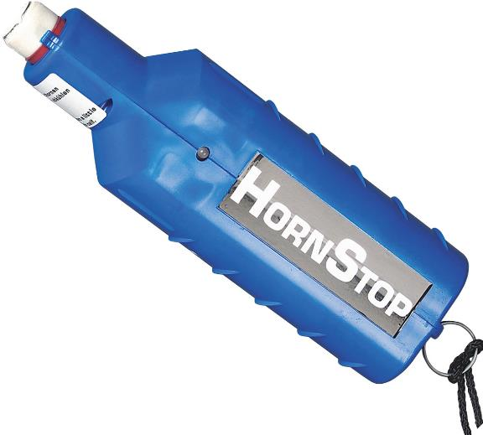
Hot Iron Dehorning Equipment

Slide 16
Hot Iron Dehorning
Advantages include:
bloodless
can be performed year-round
Disadvantages include:
animals need to be 12 weeks or older
scurs could grow following improper techniques
could cause brain damage if held in place too long

Slide 17
Hot Iron Dehorning
Steps include:
administering anesthetic
firmly restraining animal
heating iron until it is bright red
moving ears out of the way so they are not burned
pressing the tip of the iron over the horn bud
rotating iron around the base of the horn bud
ensures the horn-producing cells are destroyed

Slide 18
Hot Iron Dehorning
Steps include:
continuing application for 10 to 15 seconds
any longer could damage skull or brain
copper color will appear when dehorning is complete
Will cause horn buds to fall off within four to six weeks

Slide 19
Spoon or Tube Dehorning
Uses a sharp, metal tube-shaped device
consists of a blade in the form of a circle used to cut through the horn buds
Is used on animals younger than eight weeks of age

Slide 20
Spoon or Tube Dehorning Tools

Slide 21
Spoon or Tube Dehorning
Safety procedures include:
refraining from using during fly season
increased risk for infection
slows healing process
properly cleaning and disinfecting tools between animals

Slide 22
Spoon or Tube Dehorning
Advantages include:
useful in younger animals
quick procedure
Disadvantages include:
not bloodless
open wounds
increased risk of infection
scurs could grow following improper techniques

Slide 23
Spoon or Tube Dehorning
Steps are as follows:
administering anesthetic
covering the skin surrounding the base of the horn with the dehorning tool
size is based on the size of the horn
placing the edge directly over the horn bud
applying pressure to the tube
alternating between a push and twist motion until skin has been cut through

Slide 24
Spoon or Tube Dehorning
Steps are as follows:
cutting under the horn bud for removal
if the horn bud is not completely removed, make a small incision to remove the bud and skin
applying disinfectant to the wound
light bleeding will occur
disinfecting the cutting edge of the tube between animals

Slide 25
Cup or Scoop Dehorning
Uses scissor-like devices to remove horns
Is used on animals ranging from two to four months of age
Are available in many sizes
depends on horn size

Slide 26
Cup or Scoop Dehorning Tools
Safety precautions include:
knowing the correct placement to remove the horn
cutting too deep could open the frontal sinus
opening the frontal sinus will expose the brain cavity
refrain from using during fly season
increased risk of infection
Surgical Scoop: The frontal sinus is a cavity above the eye which helps with mucus drainage.

Slide 27
Cup or Scoop Dehorning Equipment

Slide 28
Cup or Scoop Dehorning
Advantages include:
quick
useful once the horn has attached to the skull
Disadvantages include:
requires control of bleeding
could bleed a large amount
open wounds
increases the risk of infection
could open frontal sinus
exposes brain

Slide 29
Cup or Scoop Dehorning
Steps include:
administering anesthetic or sedation
closing the handles of the dehorners together
opens blades to place the horn between them
positioning the jaws over the horn bud
pressing the blades against the head
maintain pressure
spreading handles apart to bring the blades together
this is when the removal of the horn takes place

Slide 30
Cup or Scoop Dehorning
Steps include:
controlling bleeding
clotting blood with dressing powder
pulling the artery with forceps
should only be performed by a veterinarian
cauterizing the artery with heat
Surgical Scoop: When an individual cauterizes an artery, they are burning skin to stop the bleeding.

Slide 32
Castrating
Is the process of removing testicles
Should be performed as early in the animal’s life as possible
varies from species to species
boars are castrated between four and 14 days of age
bulls are castrated before three months of age
rams and bucks are castrated between two and 21 days of age
Surgical Scoop: In the United States, 100 percent of male pigs used for meat production are castrated.

Slide 33
Castrating
Eliminates unwanted breeding
Decreases aggressiveness
Increases feed efficiency
Increases profit at market
Increases meat quality and tenderness
intact males have less fat, making meat tougher
meat from intact males can have an offensive odor and taste

Slide 34
Castration
Should be performed by a veterinarian if the following complications occur:
unilateral cryptorchidism
one testicle fails to drop into the scrotum
bilateral cryptorchidism
both testicles fail to drop into the scrotum
inguinal or scrotal hernia
part of the abdominal cavity or intestine protrudes into the scrotum

Slide 35
Castration Tools
For bulls, bucks or rams include:
elastrator
elastic rings
burdizzo
crushes the spermatic cord over the skin without surgically revealing it

Slide 36
Surgical Castration Tools
For bulls, bucks, rams or boars include:
emasculator
crushes the spermatic cord after it is revealed surgically by cutting into the scrotum

Slide 37
Elastic Bands
Use an elastrator tool to stretch rubber rings
needs to stretch far enough to slip over the scrotum and testicles
Obstruct blood flow to testicles and scrotum
within six weeks the testicles and scrotum should fall off
Are most commonly used on bulls, bucks and rams

Slide 38
Elastic Band Castration
Uses a universal tool to stretch the rubber rings
rings come in many different sizes
depends on the size of the animal and testicles
rings should be used within a year of purchase
decreases the chance of rings breaking

Slide 39
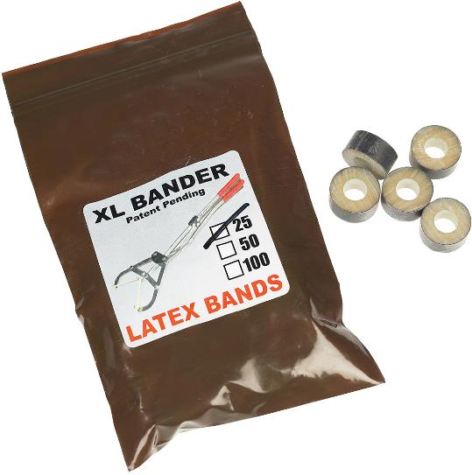
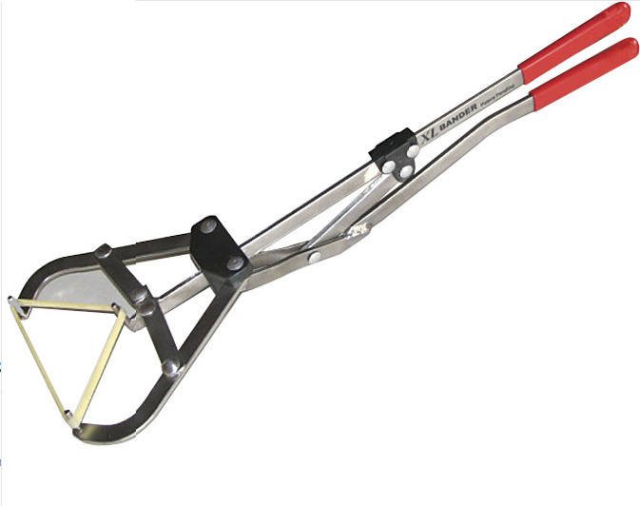
Elastrator & Elastic Bands

Slide 40
Elastic Band Castration
Safety precautions include:
restrain animals legs
ensure band is above both testicles
after procedure, conduct checkups daily to ensure procedure was completed correctly

Slide 41
Elastic Band Castration
Advantages include:
bloodless
easily performed
Disadvantages include:
wounds heal slowly
rings could break
painful
flies are attracted to the rotting skin
could lead to infection or maggot infestation

Slide 42
Elastic Band Castration
Steps are as follows:
keeping animal in a standing position
placing the band onto the elastrator tool
pulling both testicles into the scrotum
using the elastrator tool to stretch the elastic ring open and align under the scrotum
prongs should be facing up
squeeze the handles together to stretch the ring

Slide 43
Elastic Band Castration
Steps are as follows:
slipping the open ring over the scrotum and testicles
releasing the ring slightly above both testicles
ensuring both testicles are below the ring
if the ring is not properly placed, cut the ring and redo the procedure
if the ring is incorrectly placed, the scrotum and testicles will swell

Slide 44
Burdizzos
Crush blood vessels, restricting blood flow to the testicles
the scrotum will stay attached to the body, but the animal will be sterile
Are used on bulls, bucks and rams

Slide 45
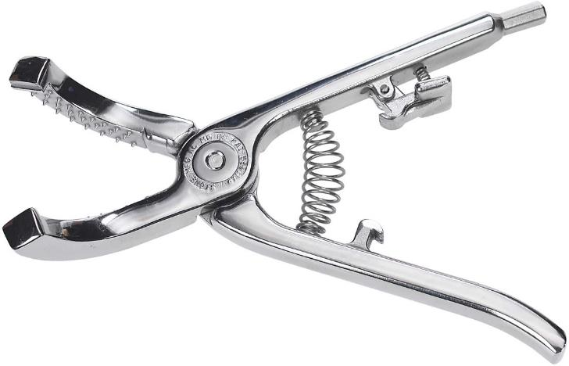
Burdizzo

Slide 46
Burdizzo Castration
Safety precautions include:
restraining animal’s legs
ensuring clamp is correctly placed on each side
holding for 10 to 45 seconds to ensure spermatic cord is severed

Slide 47
Burdizzo Castration
Advantages include:
bloodless
decreased risk of weight loss after castration
compared to surgical castrations
Disadvantages include:
slow to perform
must be held in place for 10 to 45 seconds to be effective
could result in an ineffective castration

Slide 48
Burdizzo Castration
Steps include:
selecting the correctly sized clamp
based on the size of the animal’s testicles
locating the spermatic cord
between the animal’s hind legs
moving spermatic cord to the outside of the scrotum
aligning the burdizzo or emasculator on one side of the scrotum
center it over the spermatic cord

Slide 49
Burdizzo Castration
Steps are as follows:
placing the spermatic cord between clamps
closing the clamps
hold for about 10 to 45 seconds
releasing the clamps

Slide 50
Burdizzo Castration
Steps are as follows:
repeating steps three through five on the other testicle
should be one centimeter above or below the previous clamp site
Should cause testicles to shrivel within four to six weeks
Crush Site
Spermatic cord carries blood to testicle
Testicle

Slide 51
Surgical Castration
Completely removes testicles from body
Is the most reliable form of castration
Has the best outcome when performed in dry weather
allows animals to have an easier recovery
Is used on bulls, bucks, rams and boars of all ages
Surgical Scoop: Swine can only be castrated surgically.

Slide 52
Surgical Castration
Incisions best for bulls, bucks and rams include:
either side of the scrotum
under the testicle
Incisions best for boars include:
behind and under each testicle
also referred to as the dorsal side

Slide 53
Surgical Castration
Safety precautions to follow are:
sterilizing all equipment
restraining the animal
completely anesthetized
local sedation and hands-on restraint
separating from other animals until the wound is completely healed
prevents infection and injuries

Slide 54
Surgical Castration
Disinfecting procedures are completed before and after castration is performed
Disinfecting procedures are as follows:
Disinfect all equipment and tools with an antiseptic solution such as Chlorhexidine(R) solution
Wash hands with a surgical scrub such as Chlorhexidine(R) Scrub
Disinfect the incision site with a mild disinfectant such as Iodine

Slide 55
Surgical Castration
Advantages include:
completely removes testicles
wounds heal quicker
compared to banding
Disadvantages include:
not bloodless
more time consuming
increased weight loss after procedure

Slide 56
Emasculators
Crush blood vessels, restricting blood flow
Allow the spermatic cord to be cut from the body by restricting bleeding
the testicles and spermatic cord are revealed surgically
if the spermatic cord is cut without using an emasculator the animal could bleed to death

Slide 57
Emasculator

Slide 58
Emasculator Castration
Steps are as follows:
pushing testicles to the bottom of the scrotum
making an incision from the bottom of the scrotum upwards
about two centimeters
pushing a testicle and spermatic cord through the opening of the scrotum

Slide 59
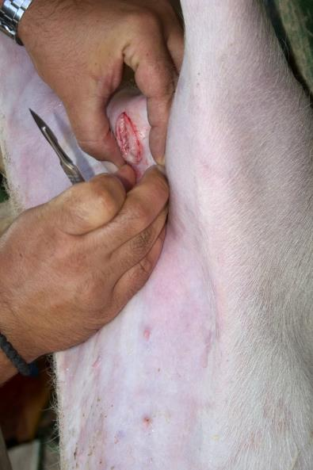
Emasculator Castration
Steps are as follows:
using the emasculator to cut the spermatic cord high above the testicle
increases blood clotting
repeating steps one through four for the other testicle

Slide 60
Castration
After care tips include:
using a dressing powder to increase clotting and reduce bleeding
keeping animals in a dry area
maximizes healing and minimizes recovery time
contacting a veterinarian, if complications occur

Slide 62
Tail Docking
Is the removal of most of an animal’s tail
Is most commonly used on lambs and pigs
Should be performed on lambs and pigs before two weeks of age
Can cause health issues if performed incorrectly
if tails are docked too short, the animal could suffer from rectal prolapses
when the rectum protrudes out of the body

Slide 63
Tail Docking
Helps prevent accumulation of urine and feces in sheep’s wool
sheep with long tails and wool have more problems with contamination
long tails can cause bacterial infections, maggot infestations and fly strike
fly strike is the invasion of fly larvae which feeds on the skin
can cause toxemia or death
blood poisoning from toxins within the blood

Slide 64
Tail Docking
Helps prevent tail biting in swine
tail biting can cause the following:
infection
abscesses in the spine
carcass damage
profit loss when harvested

Slide 65
Tail Docking
Advantages include:
decreases risk of infection
decreases tail biting
cleaner wool
Disadvantages include:
can cause rectal prolapse if docked too short

Slide 66
Tail Docking Tools
For sheep include:
elastrator
For swine include:
teeth clippers
scissors
scalpel blade
burdizzo instrument
Surgical Scoop: Some dairy farmers also dock tails to aid in the sanitation of the milking process.

Slide 67
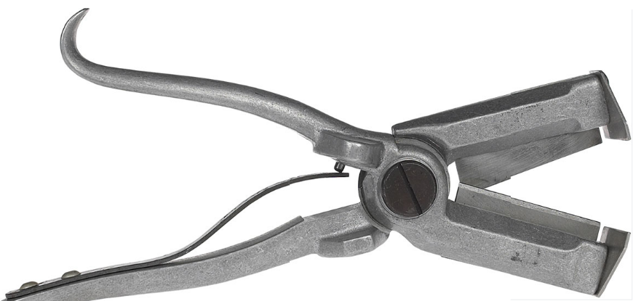
Tail Docking Tools

Slide 68
Tail Docking
Steps for lambs include:
opening the elastrator and inserting the tail into the rubber ring
placing the ring beyond the caudal folds of the skin
releasing the ring onto the tail
after a few days, the tail should fall off
tail may need to be cut beneath the band if it does not fall off in a timely manner
applying disinfectant solution to the area

Slide 69
Tail Docking
Steps for pigs are as follows:
aligning the tail inside the tooth nippers at the desired location
should be anywhere from a 1/2 inch to one inch from the base of the tail
firmly pressing on the nippers to puncture through the skin and vertebrae
applying disinfectant solution to the area

Slide 70
Tail Docking
Should be performed within the animal’s first week of life
Safety precautions to follow include:
knowing proper placement to remove tail
using sterile tools

Slide 71
Teeth Clipping
Involves cutting piglets’ incisor teeth
sharp, narrow teeth located toward the front of the mouth
Helps reduce trauma to sows’ teats and other piglets
piglets will fight, using these teeth, to claim a teat for feeding purposes
fighting could cause bodily harm
increases the risk of infection in young piglets
Is only used in the swine industry

Slide 72
Teeth Clipping
Should be completed within 24 hours of the piglets’ birth
Removes the incisor teeth of piglets
piglets use incisor teeth to fight for the best teat during feeding
incisor teeth cause damage to the mother’s teats

Slide 73
Teeth Clipping Tools
For young swine include:
“teeth clippers”, which can be side cutters, wire cutters or large toenail clippers

Slide 74
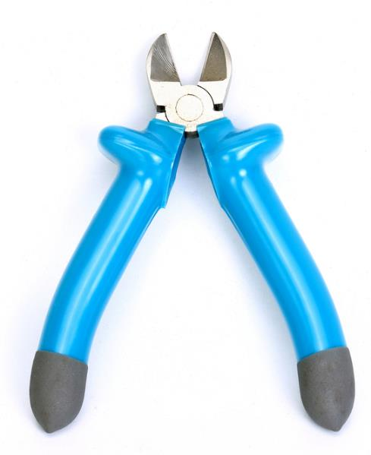
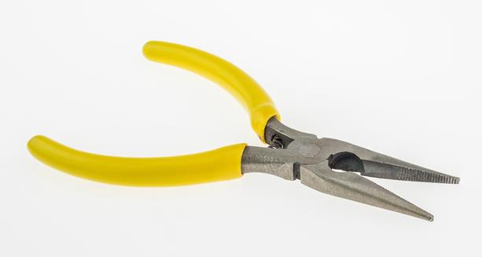
Teeth Clipping Tools

Slide 75
Teeth Clipping
Safety precautions include:
knowing proper teeth to clip
using sterile tools
clipping teeth at the proper length
right below the gum line

Slide 76
Teeth Clipping
Advantages include:
reduce trauma to sow’s teats
reduce bodily harm to other piglets
Disadvantages include:
painful if clipped too far down
bleeding if the gum is clipped

Slide 77
Teeth Clipping
Steps are as follows:
restraining piglet by cradling between the body and forearm
opening the piglet’s mouth
restraining piglet’s tongue using a finger
clipping each incisor tooth right below the gum line
be careful to not clip the gum
rubbing finger over clipped teeth to ensure there are no sharp edges

Slide 78
Lancing
Is puncturing an abscess to release fluid
Is needed when a wound or infection has swelled and filled with fluid
Removes harmful bacteria which causes infection within the body

Slide 79
Lancing
Releases fluid under the skin of an animal
Is most commonly used to treat abscesses
develop from cuts or puncture wounds

Slide 80
Lancing Tools
For an abscess include:
razor blade
knife
scalpel

Slide 81
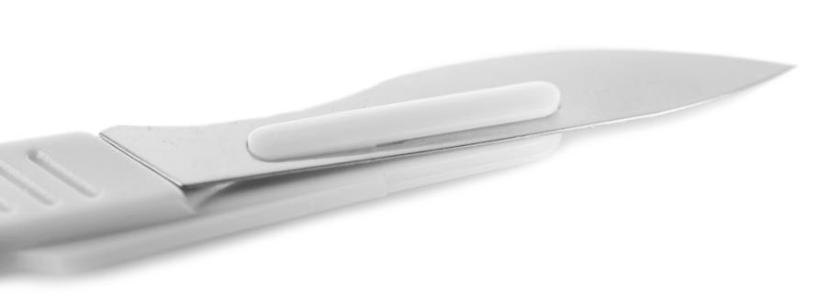
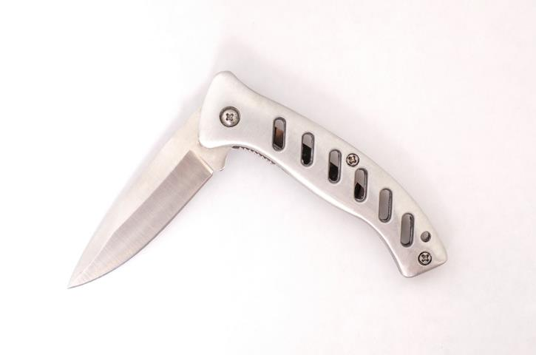
Lancing Tools

Slide 82
Lancing
Safety precautions include:
making an incision large enough to release fluid
using sterile tools
wearing gloves

Slide 83
Lancing
Advantages include:
releases fluid
decreases pain
cleans infections
Disadvantages include:
leaves an open wound
needs hydrotherapy to heal properly

Slide 84
Lancing
Steps are as follows:
cleaning equipment with a disinfectant
cleaning infected area with a disinfectant
holding one side of the abscessed area with one hand
cutting an incision through the center of the abscess with the other hand
applying pressure to the infected area to expel the majority of the fluid
fluid could be blood or pus

Slide 85
Lancing
Steps are as follows:
applying a disinfectant into the incision site, using a needleless syringe, to finish cleaning the wound
continuing cleaning wound via hydrotherapy until healed
Surgical Scoop: To help the healing process after lancing an abscess, a constant stream of water is applied to the wound for a few minutes a day until the wound is healed. This healing process is known as
hydrotherapy.

Slide 86
Resources
http://www.omafra.gov.on.ca/english/livestock/dairy/facts/09-003.htm#bud
https://www.aphis.usda.gov/animal_health/nahms/beefcowcalf/downloads/beef0708/Beef0708_dr_PartI_rev.pdf
http://web.jhu.edu/animalcare/procedures/survival-large.html
http://www.dpi.nsw.gov.au/agriculture/livestock/beef/husbandry/general/dehorning-cattle
http://www.thepigsite.com/pighealth/article/555/docking-tail-clipping-piglets/
https://extension.tennessee.edu/publications/documents/pb1684.pdf
http://beefmagazine.com/health/0401-castrate-calves-timing
http://animalsmart.org/species/pigs/swine-castration

Slide 87
Resources
http://www.esgpip.org/pdf/Technical%20bulletin%20No.%2018.pdf
https://www.cals.ncsu.edu/an_sci/extension/animal/news/janfeb96/jf963art.html
http://www.sdstate.edu/vs/extension/beef-castration.cfm
http://www.ciwf.com/farm-animals/pigs/welfare-issues/tooth-clipping/
http://www.motherearthnews.com/homesteading-and-livestock/wound-management-for-farm-animals-zmaz00djzgoe.aspx
http://www.leawhitefarms.com/castration.htm
http://kinne.net/latehrn1.htm
http://www.mayoclinic.org/diseases-conditions/inguinal-hernia/basics/causes/con-20021456

Slide 88
Acknowledgements
Production Coordinator
Ashley Pearson
Assistant Brand Manager
Amy Hogan
Graphic Designer
Melody Rowell
V.P. of Brand Management
Clayton Franklin
Executive Producer
Gordon W. Davis, Ph.D.
CEV Multimedia, Ltd.
©MMXVI

