Slide 1
Beef Cattle Breeds

Slide 2
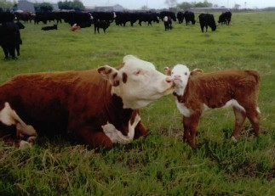
Breeds of Beef Cattle
BOS TAURUS

Slide 3
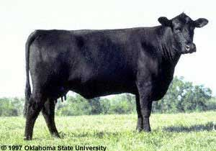
Angus
Originated in Scotland
Entirely black in color
Naturally Polled
Excellent marbling ability
Excellent maternal breed

Slide 4
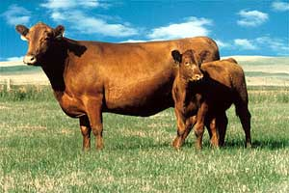
Red Angus
Originated in the United States around 1945
Developed from a recessive gene found in black angus cattle
Red in color
Naturally polled

Slide 5
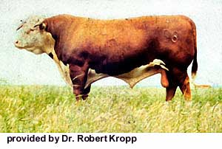
Hereford
Originated in England
Red with a white face, switch, underline, and a strip extending from the top of the neck to the shoulders. There is some white on the feet which extends upwards.
Horned
Low to moderate milking ability
Adaptable to many environments

Slide 6
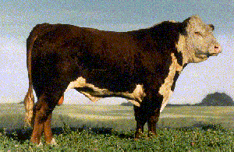
Polled Hereford
Originated in the United States
Polled
Color markings the same as Herefords
Realized that polled cattle had advantages in production and handling on a commercial basis.

Slide 7
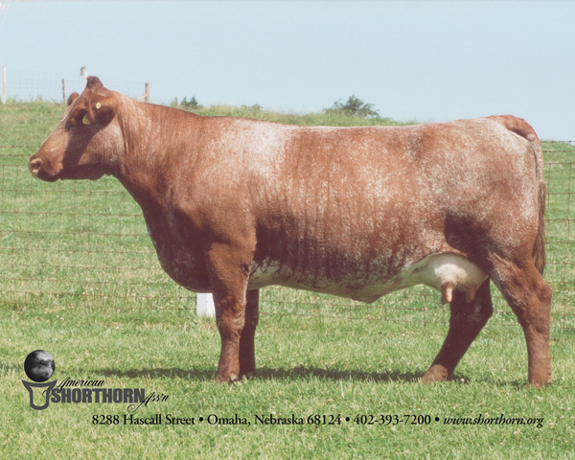
Shorthorn
Originated in England
There are three major colors: red, white, and roan
Both polled or horned
Excellent milk production
Moderate size

Slide 8
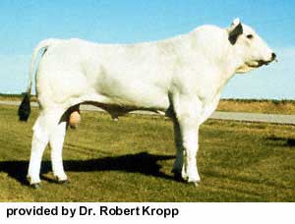
Chianina
Originated in Italy
Probably one of the oldest breeds in the world
White, with black skin pigment and switch
Polled
Largest breed of cattle

Slide 9
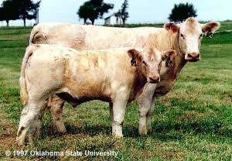
Charolais
Originated in France
White, with pink skin
Both horned and polled.
They are large, heavily muscled breed.

Slide 10
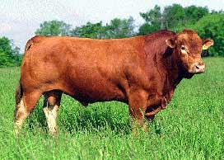
Gelbvieh
Originated in Germany
Red in color
Horned and polled
Noted for superior fertility and milking ability

Slide 11
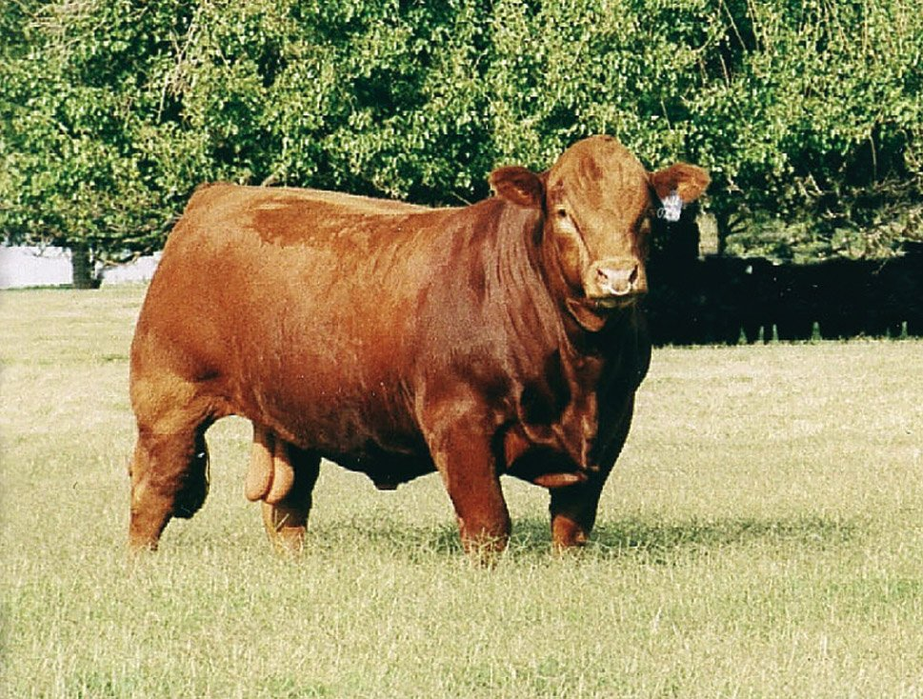
Limousin
Originated in France
Color varies from light yellow, to red, to black
Horned and polled
Noted for their carcass leanness

Slide 12
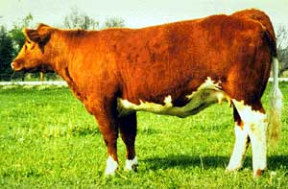
Maine Anjou
Originated in France
Dark red and white in color
Horned
Considered an excellent beef producer

Slide 13
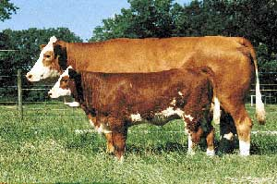
Simmental
Originated in Switzerland
Light to dark red in color, with a white face. Some are spotted.
Horned
Thick muscled and produce a lean carcass.

Slide 14
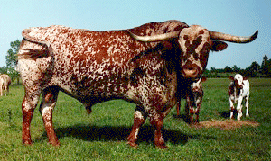
Texas Longhorn
Originated from Spanish cattle brought by Columbus
Texas Longhorn was almost extinct by 1900
Have distinct horns that spread 4 feet or more
Noted for their hardiness, fertility, and longevity

Slide 15
Breeds of Beef Cattle
Bos Indicus

Slide 16
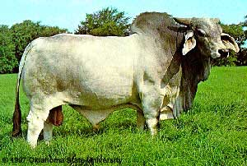
Brahman
Developed in the United States
Color ranges from light gray or red to almost black.
Horned
Brahman cattle are noted for their
Heat tolerance
Disease and insect resistance
Crossing Ability

Slide 17
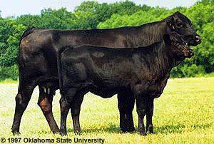
Brangus
Originated in the United States
5/8 Angus and 3/8 Brahman
Black
Naturally polled
Most widespread “composite” breed in the US.
Early Maturing
High Heat Tolerance
Moderate in Size

Slide 18
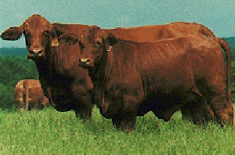
Red Brangus
Developed in Texas
Red in color
Naturally polled
Characteristics similar to the Brangus

Slide 19
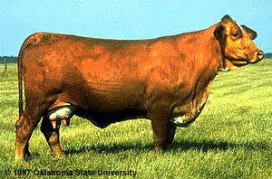
Beefmaster
Developed in Texas
Composite breed
25% Hereford, 25% Shorthorn, and 50% Brahman
No set color pattern
Horned and polled
Beefmasters are noted for longevity, hardiness, rapid growth, and maternal ability.

Slide 20
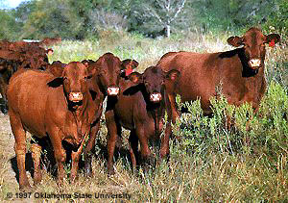
Santa Gertrudis
Developed in Texas
5/8 Shorthorn and 3/8 Brahman
Dark red in color
Both polled and horned
Noted for maternal ability, productivity under hot, adverse conditions, and overall hardiness.

Slide 21
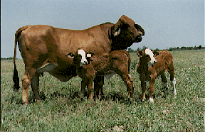
Simbrah
Developed in the United States
5/8 Simmental and 3/8 Brahman
Heat and insect tolerance
Hardiness
Maternal characteristics: calving ease, fertility, milking ability

