Slide 1
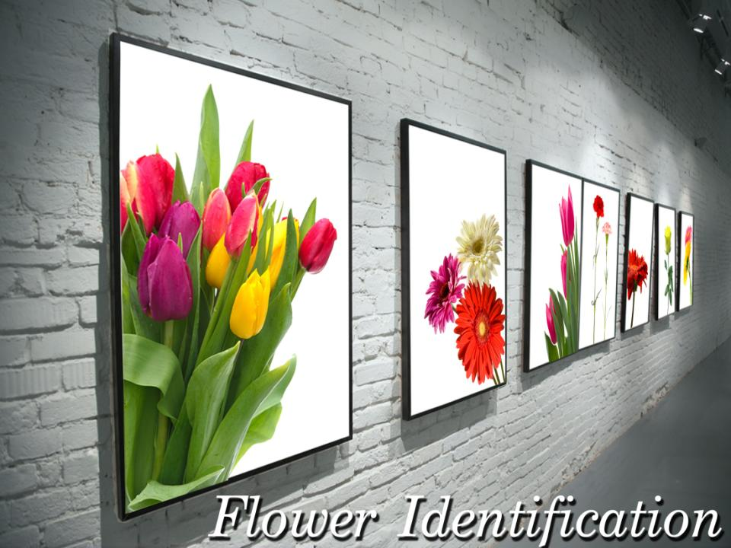

Slide 2
Objectives
To identify flowers and other floral materials.
To discover the botanical and common names of flowers and other floral materials.
To analyze flower characteristics.

Slide 3
Main Menu
Line Flowers
Mass Flowers
Form Flowers
Filler Flowers
Foliage & Greenery
Potted Plants

Slide 4
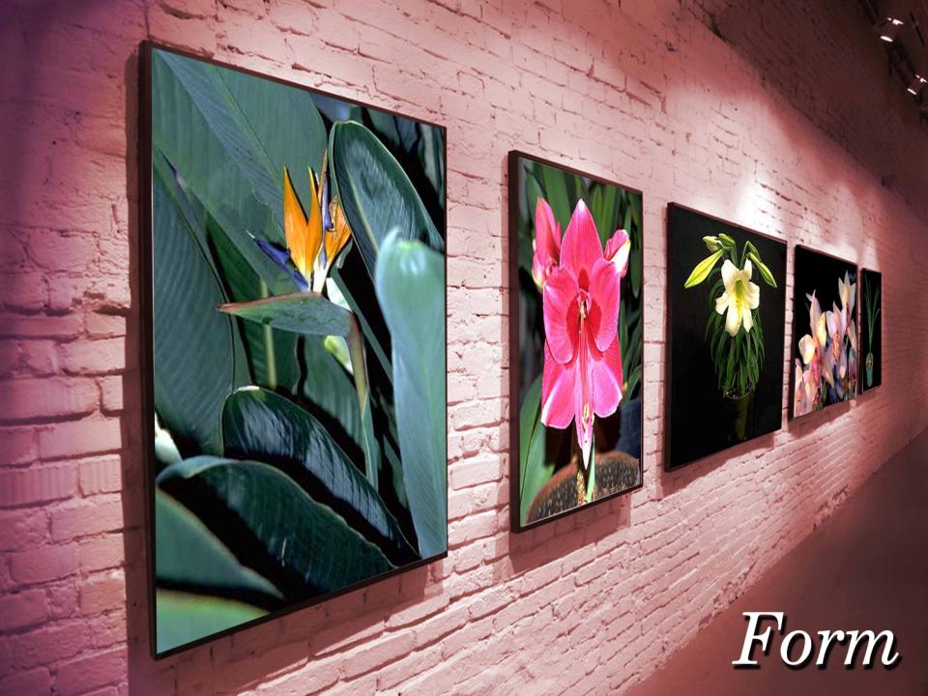
Return to
Main Menu

Slide 5
Form Flowers
Are used to create focal point with unusual and distinctive shapes

Slide 6
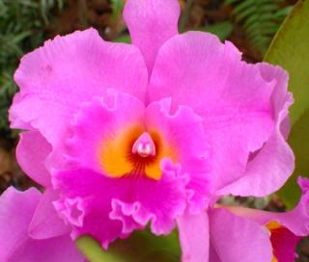
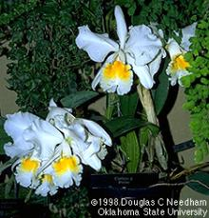
Cattleya Orchid Hybrid
Botanical name: Cattleya cv.
Origin: Costa Rica and South America
Color: shades of violet, pink, white and yellow

Slide 7
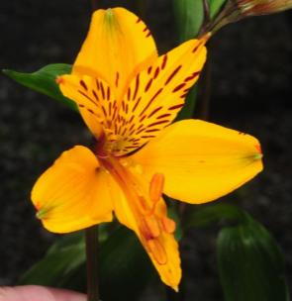
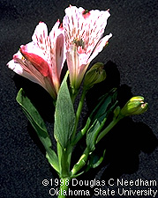
Peruvian Lily
Botanical name: Alstroemeria aurantiaca
Origin: South America
Color: tints of white, pink, yellow, red, green, orange and mauve

Slide 8
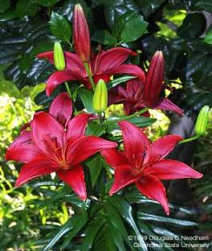
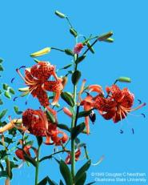
Hybrid (Garden) Lily
Botanical name: Lilium x hyrbridum cv.
Origin: Japan and Taiwan
Color: waxy white, pink or orange

Slide 9
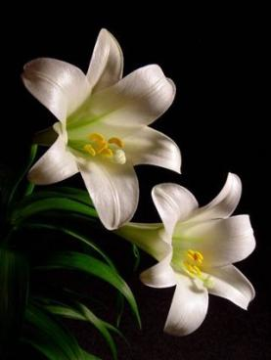
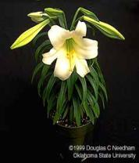
Trumpet (Easter) Lily
Botanical name: Lilium longiflorum cv.
Origin: Japan and Taiwan
Color: white, pink and salmon

Slide 10
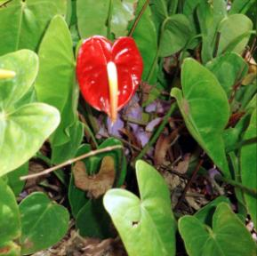
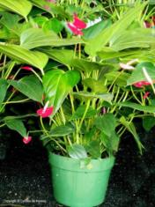
Anthurium, Flamingo Lily
Botanical name: Anthurium x andraenum cv.
Origin: South and Central America
Color: red, orange, pink, salmon and white

Slide 11
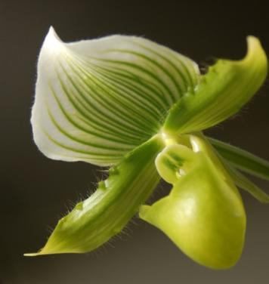
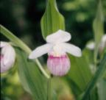
Ladyslipper Orchid
Botanical name: Paphiopedilum x hybrid cv.
Origin: North America, Europe and Asia
Colors: background colors are generally white, yellow or green

Slide 12
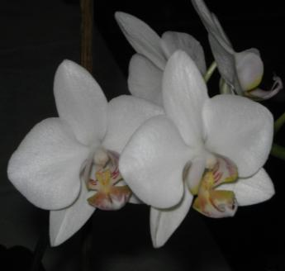
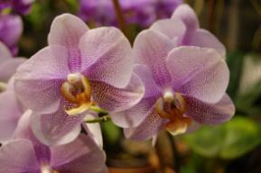
Phalaenopsis (Butterfly) Orchid
Botanical name: Phalaenopsis cv.
Origin: southeast Asia
Color: white with yellow and orange marking on the throat, sometimes a pinkish violet

Slide 13
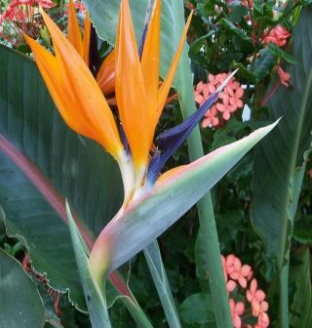
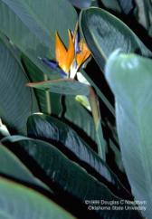
Bird-of-Paradise
Botanical name: Strelitzia reginae
Origin: South Africa
Color: deep orange outer petals with deep blue inner petals enclosed in green outer sheath

Slide 14
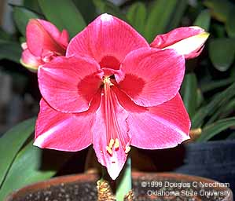
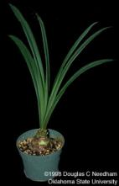
Amaryllis
Botanical name: Hippeastrum hybrid cv.
Origin: South Africa
Color: red, pink and white

Slide 15
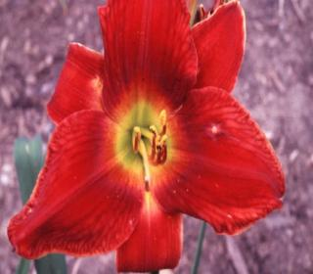
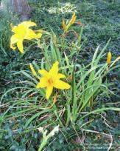
Daylily
Botanical name: Hemerocallis cv.
Origin: Europe, China, Japan and Korea
Color: yellow, pink, red and white

Slide 16
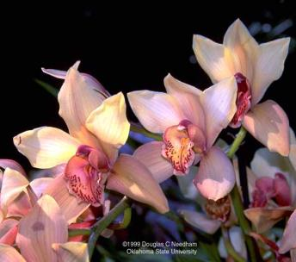
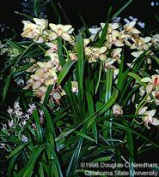
Cymbidium Orchid
Return to
Main Menu
Botanical name: Cymbidium cv.
Origin: Asia and northern Australia
Color: pink, yellow, white or green

Slide 17
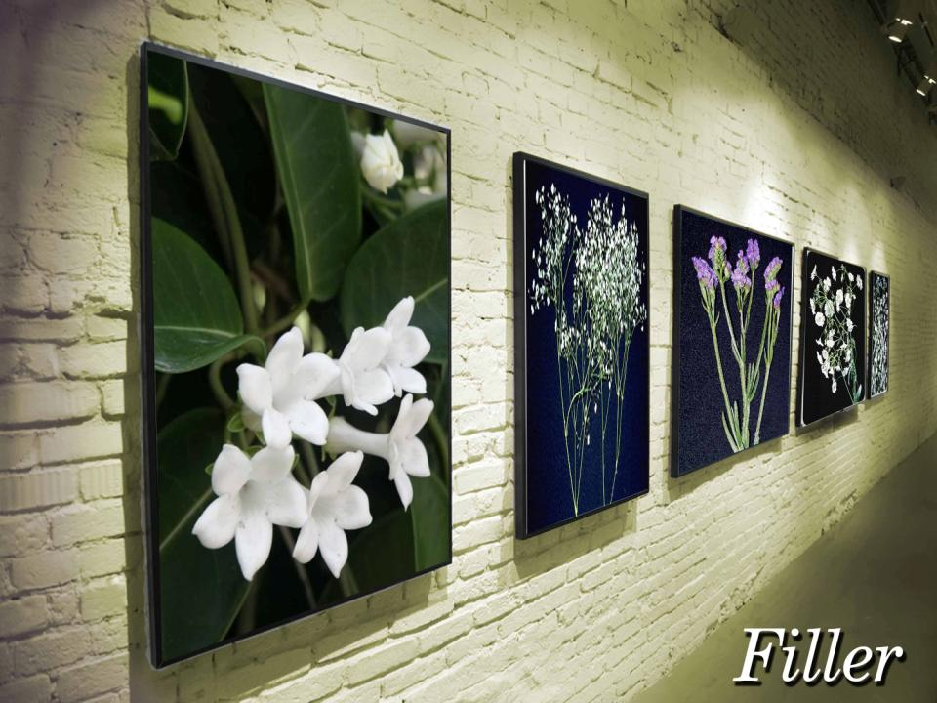
Return to
Main Menu

Slide 18
Filler Flowers
Are flowers used to complete a design by adding depth

Slide 19
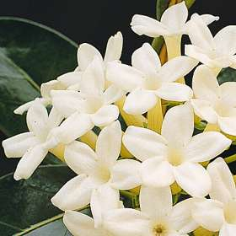
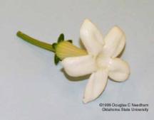
Stephanotis
Botanical name: Stephanotis floribunda
Origin: Africa
Color: white

Slide 20
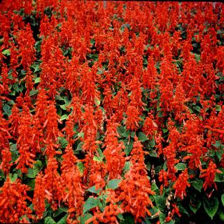
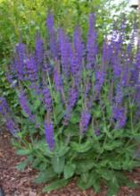
Salvia
Botanical name: Salvia splendens cv.
Origin: Central and South America, Asia and the Mediterranean
Color: purple and red

Slide 21
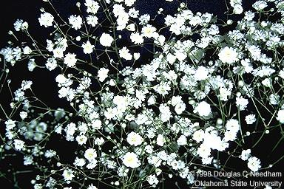
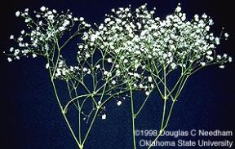
Baby’s Breath
Botanical name: Gypsophila elegans cv.
Origin: Europe, Asia and north Africa
Color: white

Slide 22
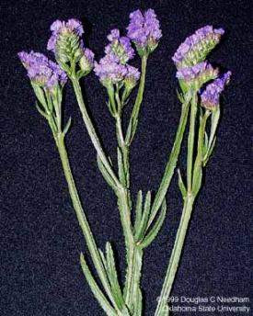
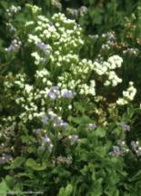
Statice
Botanical name: Limonium sinuatum
Origin: central Asia, Mediterranean region and the Canary Islands
Color: blue, violet, mauve, white and yellow

Slide 23
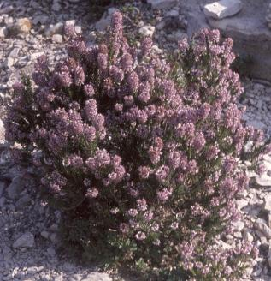
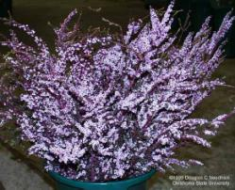
Spring Heather
Botanical name: Erica carnea cv.
Origin: mountainous areas of central and southern Europe
Color: purple, white and green

Slide 24
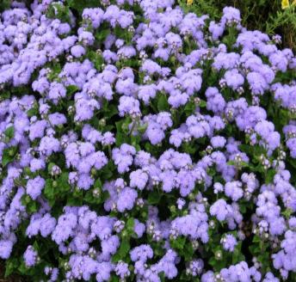
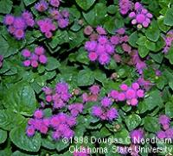
Ageratum
Botanical name: Ageratum mexicanum
Origin: Central America and Mexico
Color: violet, blue, pink and yellow

Slide 25
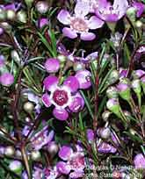
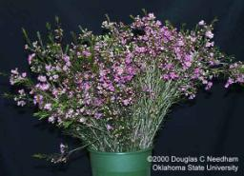
Waxflower
Return to
Main Menu
Botanical name: Chamelaucium uncinatum
Origin: western United States
Color: white and purple

